Slide 1
W4111 – Introduction to Databases Section 003, V03, Fall 2024 Lecture 2: ER, Relational, SQL (1)
© Donald F. Ferguson, 2024

Slide 2
W4111 – Introduction to Databases Section 003, V03, Fall 2024 Lecture 2: ER, Relational, SQL (1)
We will start in a minute.
© Donald F. Ferguson, 2024

Slide 3

Today’s Contents
3 | COMS W4111_003_2024_3: Lecture 2: ER, Relational, SQL (I) © Donald F. Ferguson, 2024

Slide 4
Contents
Introduction and course updates.
ER Modeling (1).
Relational model and algebra (1).
SQL (1).
Homework and projects.

Slide 5
Introduction and course updates
5 | COMS W4111_003_2024_3: Lecture 2: ER, Relational, SQL (I) © Donald F. Ferguson, 2024

Slide 6
Course Updates
TAs –
We should have a complete set of TAs by the weekend.
I will be meeting with them to setup GradeScope and submission for HW 0.
Grading
Grading will be on a scale of 0 to 100 points.
Exams
In class midterm is 25 points (2024-OCT-18). Probably not full lecture time.
Final exam is in classroom on scheduled date and is 50 points.
Homework
There will be 5 homework assignments, each worth 5 points.
These will be a combination of written questions and code/practical tasks.
After the 5 homework assignments, you will have completed a small project.

Slide 7
Final Exam Schedule
https://registrar.columbia.edu/content/student-exams
Student Exams
Final examinations are given at the end of each term. The Projected University Examination Schedule provides a tentative guide to final examinations and is available online.
Projected and Final Exam dates may include Religious Holidays for some students. NYS Education Law §224-A mandates that faculty make available an opportunity to make up any examination missed because of religious beliefs. To facilitate the preparation of makeup exams, students intending to be absent to observe any of these holidays must notify the instructor by October 15 in the fall semester and February 15 in the spring semester.
The definitive schedule of final examinations is usually available in early to mid November for the fall term and early to mid April for the spring term. Exams are scheduled according to a University-wide Final Exam Schedule available shortly after midterms. Prior to its availability, students and faculty should consult the Projected Exam Schedule. Students may access their individual exam schedule in Vergil by clicking on "Schedule," then "My Exam Schedule."
Students who have trouble locating a class on either list should contact the instructor to make sure the class has an exam.

Slide 8
ER Modeling
8 | COMS W4111_003_2024_3: Lecture 2: ER, Relational, SQL (I) © Donald F. Ferguson, 2024

Slide 9
Concepts
Introduction
9 | COMS W4111_003_2024_3: Lecture 2: ER, Relational, SQL (I) © Donald F. Ferguson, 2024

Slide 10
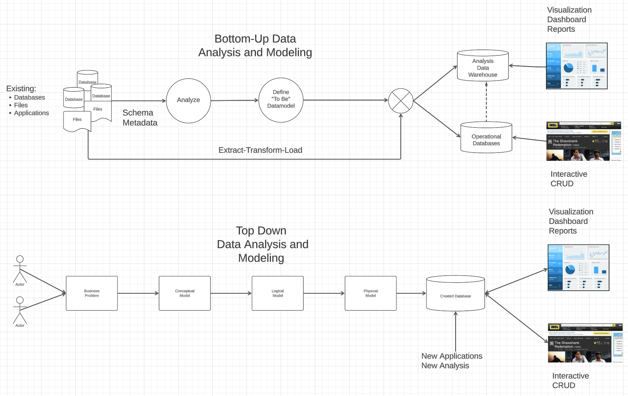
Modeling
Most of the time there is a mix → Meet-in-the-Middle

Slide 11
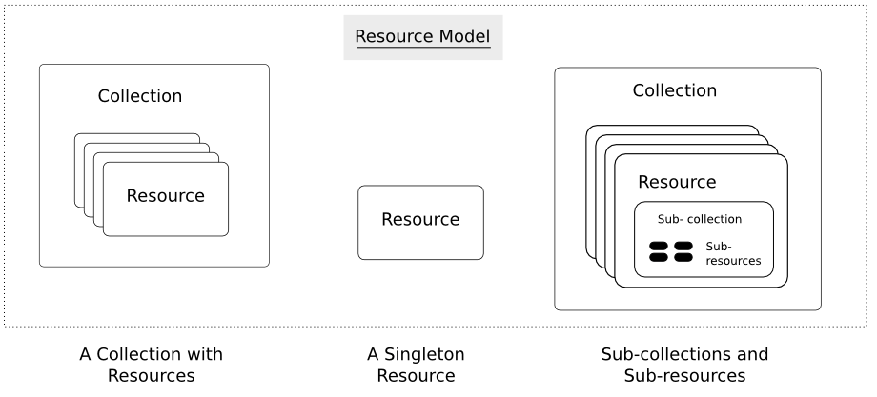
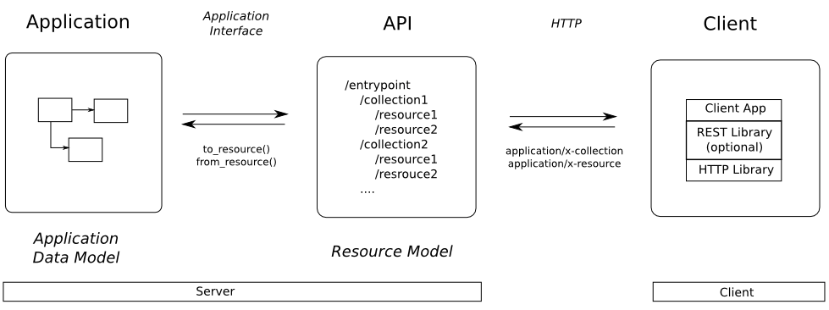
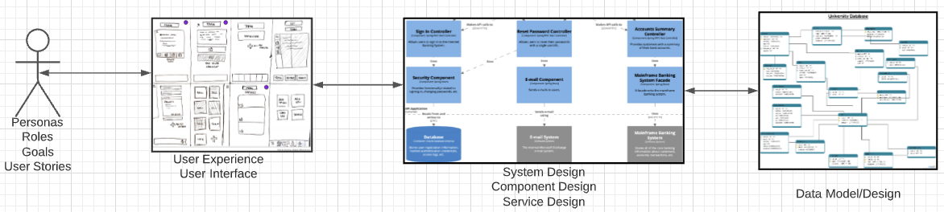
Web Application Problem Statement
We must build a system that supports create, retrieve, update and delete for IMDB and Game of Thrones Datasets.
This requires implementing create, retrieve, update and delete (CRUD) for resources.
We will design, develop, test and deploy the system iteratively and continuously.
There are four core domains.
https://restful-api-design.readthedocs.io/en/latest/resources.html
In this course,
We focus on the data dimension.
We will get some insight into the other dimensions.

Slide 12
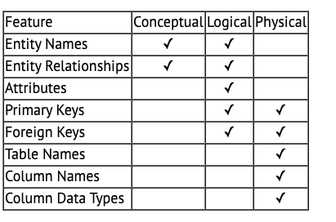
A Common and my Approach: Conceptual → Logical → Physical
https://ehikioya.com/conceptual-logical-physical-database-modeling/
https://www.1keydata.com/datawarehousing/data-modeling-levels.html
It is easy to get carried away with modeling. You can spend all your time modeling and not actually build the schema.
We will use the approaches in class.
Mostly to understand concepts and patterns.
https://www.1keydata.com/datawarehousing/data-modeling-levels.html

Slide 13

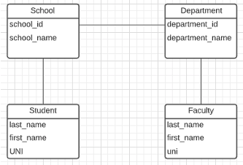
ER Model and ER Modeling
ER Model
Generalization
ER Model: Agility, Separation of Concerns
ER model is a generalization that most DB models implement in some form.
Using the ER model enables:
Thinking about and collaborating on design with getting bogged down in details.
Enable flexible choices about how to realize/Implement data.
ER Diagrams: Communication, Quality, Precision
With a little experience, everyone can understand and ER diagram.
Easier to discuss and collaborate on application’s data than showing SQL table definitions, JSON, ... ...
People think visually. That is why we have whiteboards. ER diagrams are precise and unambiguous.
Guides you to think about relationships, keys, ... And prevents “re-dos” later in the process. It is easier to fix a diagram than a database schema.
Specialization
Relational
Doc Model
Graph Model
... ...
UI UX
Business Professional
Business Service Developer
DB Pros

Slide 14
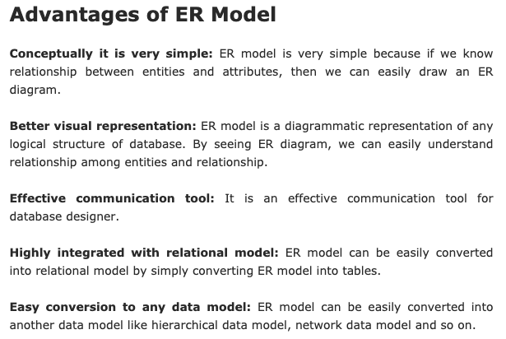
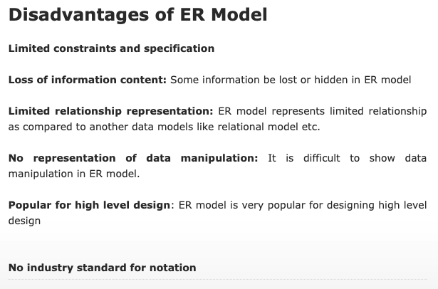
ER Modeling – Reasonably Good Summary
https://pctechnicalpro.blogspot.com/2017/04/advantages-disadvantages-er-model-dbms.html
Note:
If you get to use Google to help with take home exams, HW, etc.
I get to use Google to help with slides.

Slide 15
Entity-Relational Model Reminder
Introduction
15 | COMS W4111_003_2024_3: Lecture 2: ER, Relational, SQL (I) © Donald F. Ferguson, 2024

Slide 16
Entity Sets
An entity is an object that exists and is distinguishable from other objects.
Example: specific person, company, event, plant
An entity set is a set of entities of the same type that share the same properties.
Example: set of all persons, companies, trees, holidays
An entity is represented by a set of attributes; i.e., descriptive properties possessed by all members of an entity set.
Example:
instructor = (ID, name, salary ) course= (course_id, title, credits)
A subset of the attributes form a primary key of the entity set; i.e., uniquely identifying each member of the set.
DFF Comments:
Some of these statements apply primarily to OO systems and the relational/SQL models.
A motivation for “No SQL” is to relax the constraints.

Slide 17
Entity Sets -- instructor and student
(10101, 98988)
(10101,76543)

Slide 18
Relationship Sets
A relationship is an association among several entities
Example: 44553 (Peltier) advisor 22222 (Einstein) student entity relationship set instructor entity
A relationship set is a mathematical relation among n ≥ 2 entities, each taken from entity sets
{(e₁, e₂, … e_{n}) | e₁ ∈ E₁, e₂ ∈ E₂, …, e_{n} ∈ E_{n}} where (e₁, e₂, …, e_{n}) is a relationship
Example:
(44553,22222) ∈ advisor
DFF Comments:
Nobody thinks about relationships this way.
There is no idea so simple that a DB professor cannot make it confusing, usually by using math.

Slide 19
Relationship Sets (Cont.)
Example: we define the relationship set advisor to denote the associations between students and the instructors who act as their advisors.
Pictorially, we draw a line between related entities.
DFF Comment:
In this diagram, the lines are the relationship set.
Many DB models use a 3rd entity set to represent complex relationships.
DFF Comments:
Nobody draws the diagrams this way, but ...
Sometimes thinking this way helps understand other ways to depict the concept.

Slide 20
Visual Notation
Introduction
20 | COMS W4111_003_2024_3: Lecture 2: ER, Relational, SQL (I) © Donald F. Ferguson, 2024

Slide 21
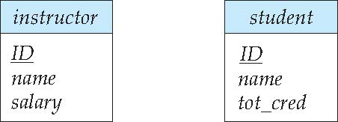
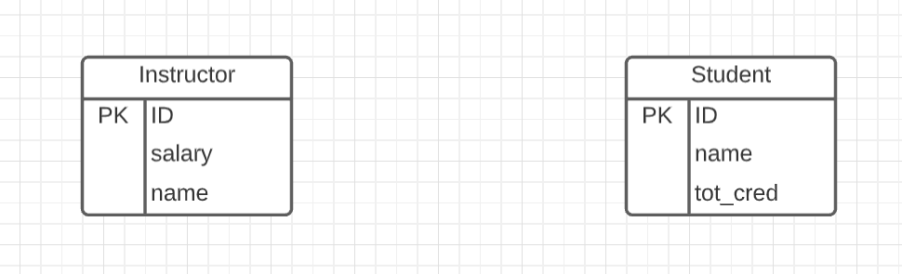
Representing Entity sets in ER Diagram
Entity sets can be represented graphically as follows:
Rectangles represent entity sets.
Attributes listed inside entity rectangle
Underline indicates primary key attributes
“Visual modeling is the use of semantically rich, graphical and textual design notations to capture software designs. A notation, such as UML, allows the level of abstraction to be raised, while maintaining rigorous syntax and semantics. In this way, it improves communication in the design team, as the design is formed and reviewed, allowing the reader to reason about the design, and it provides an unambiguous basis for implementation.”
Crow’s Foot Notation

Slide 22
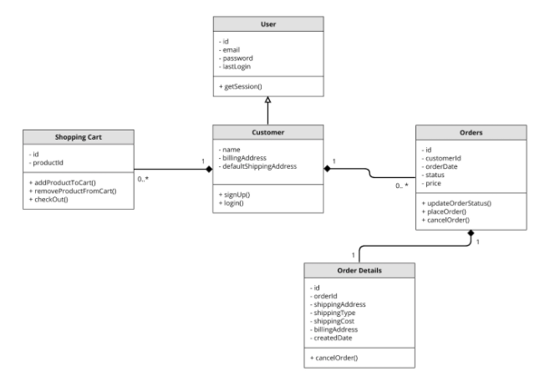
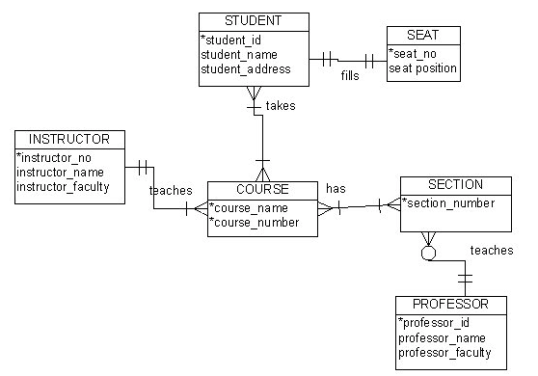
Visual Notation – Many Notations
ER Model
UML
“Other,” i.e. PowerPoint is the most common modeling notation.
It is easy to get “carried away.”
The trick is to do “just enough modeling.”
I mostly use Crow’s Foot
It is “just enough”
But lacks some capabilities.
The book uses ER notation.
Crow’s Foot

Slide 23
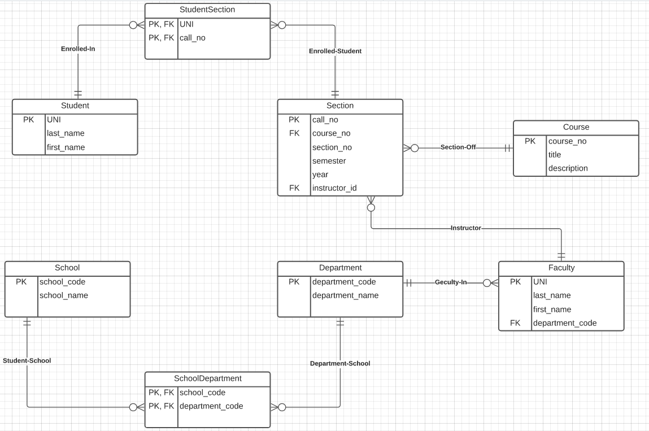
Notation has Precise Meaning (Crow’s Foot)
Attribute annotations:
PK = Primary Key
FK = Foreign Key
Line annotations:
We will learn over time and there are good tutorials (https://www.lucidchart.com/pages/er-diagrams) to help study and refresh.
We will spend a lot of time discussing keys.
We will start in a couple of slides.

Slide 24
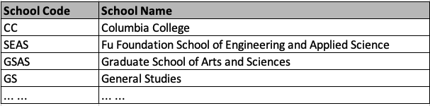

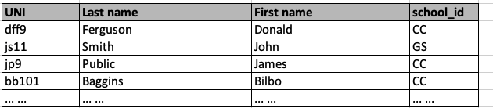
What Does this Mean? Let’s Get Started
Primary Key means that the value occurs at most once.
Student.school_id references school.school_code
Foreign Key means that if a value occurs in school_id for any row, there must be a row in School with that key.
The line notations mean:
A student is related to EXACTLY ONE school.
A School may be related to 0, 1 or many students.

Slide 25
Worked Example
We will do a worked example in LucidChart

Slide 26
Relational Model
26 | COMS W4111_003_2024_3: Lecture 2: ER, Relational, SQL (I) © Donald F. Ferguson, 2024

Slide 27

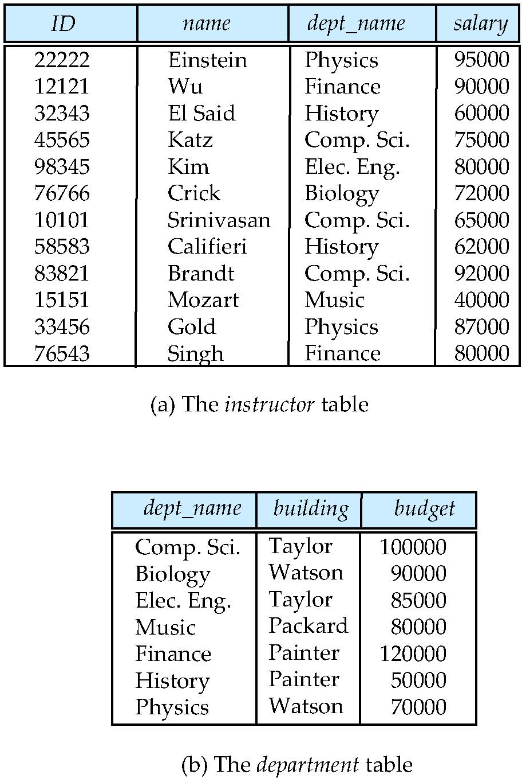
Relational Model
All the data is stored in various tables.
Example of tabular data in the relational model
Columns
Ted Codd Turing Award 1981
The “relation” is the “table.”
In my big space of pieces of data. ID, name, dept_name, salary are somehow related.
This causes confusion, because the ER and other models use “relation” to mean something else.
Core concepts:
Relation
Tuple (Row)
Column (Attribute)
Rows
Notes:
27

Slide 28
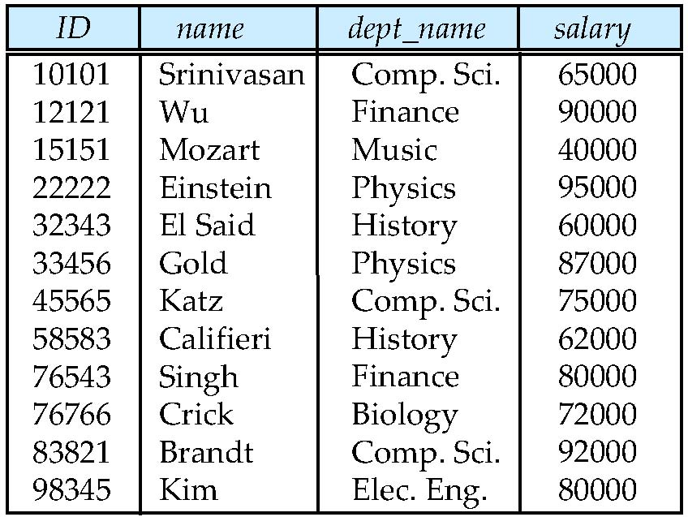
Example of a Instructor Relation
attributes
(or columns)
00123
123
tuples
(or rows)
Integer
-213
(integers, >0 )

Slide 29
Attribute
The set of allowed values for each attribute is called the domain of the attribute
Attribute values are (normally) required to be atomic; that is, indivisible
The special value null is a member of every domain. Indicated that the value is “unknown”
The null value causes complications in the definition of many operations
COMSW4111
Ferguson, Donald
Ferguson
Donald
DFF Comments:
I will explain the importance of atomic attributes and null in examples.
Atomic and use of Null is important!

Slide 30
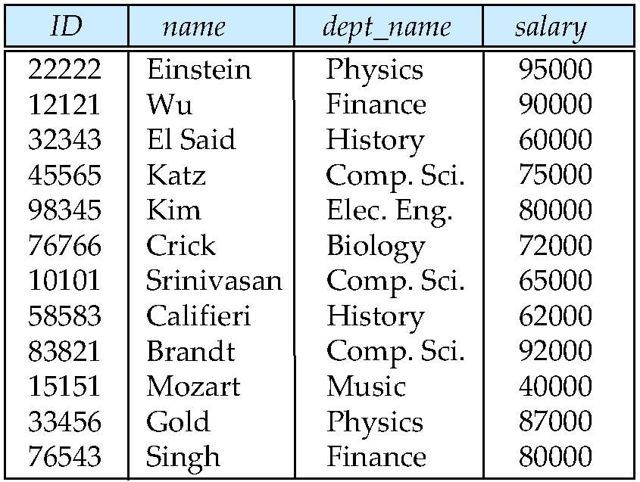
Relations are Unordered
Order of tuples is irrelevant (tuples may be stored in an arbitrary order)
Example: instructor relation with unordered tuples

Slide 31
Database Schema
Database schema -- is the logical structure of the database.
Database instance -- is a snapshot of the data in the database at a given instant in time.
Example:
schema: instructor (ID, name, dept_name, salary)
Instance:
instructor (ID, name, dept_name, salary)

Slide 32
Keys
Let K ⊆ R
K is a superkey of R if values for K are sufficient to identify a unique tuple of each possible relation r(R)
Example: {ID} and {ID,name} are both superkeys of instructor.
Superkey K is a candidate key if K is minimal Example: {ID} is a candidate key for Instructor
One of the candidate keys is selected to be the primary key.
which one?
Foreign key constraint: Value in one relation must appear in another
Referencing relation
Referenced relation
Example: dept_name in instructor is a foreign key from instructor referencing department

Slide 33
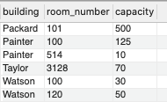
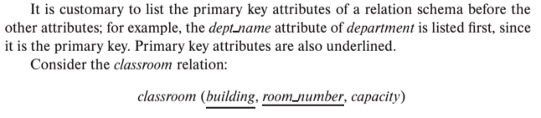
Notation
Classroom relation
classroom schema
Columns (Attributes)
Relation Name
Primary Key Columns
The primary key is a composite key. Neither column is a key (unique) by itself.
Keys are statements about all possible, valid tuples and not just the ones in the relation.
Capacity is unique in this specific data, but clearly not unique for all possible data.
In this domain, there cannot be two classrooms with the same building and room number.
Relation schema:
Underline indicates a primary key column. There is no standard way to indicate other types of key.
We will use bold to indicate foreign keys.
You will sometimes see things like classroom(building:string, room_number:number, capacity:number)

Slide 34
Observations
Keys:
Will be baffling. It takes time and experience to understand/appreciate.
There are many, many types of keys with formal definitions.
I explain the formality but focus on the concepts and applications.
No one uses the formal, relational model. So, why do we study it?
Is very helpful when understanding concepts that we cover later in the course, especially query optimization and processing.
There are many realizations of the model and algebra, and understanding the foundation helps with understanding language/engine capabilities.
The model has helped with innovating new approaches, and you may innovate in data and query models in your future.

Slide 35
Relational Query Languages
Procedural versus non-procedural, or declarative
“Pure” languages:
Relational algebra
Tuple relational calculus
Domain relational calculus
The above 3 pure languages are equivalent in computing power
We will concentrate in this chapter on relational algebra
Not turning-machine equivalent
Consists of 6 basic operations
DFF Comments:
You will sometimes see other operator, e.g. ← Assignment.
Relational algebra focuses on retrieve. You can sort of do Create, Update, Delete.
The SQL Language, which we will see, extends relational algebra.

Slide 36
Relational Algebra
A procedural language consisting of a set of operations that take one or two relations as input and produce a new relation as their result.
Six basic operators
select: σ
project: ∏
union: ∪
set difference: –
Cartesian product: x
rename: ρ

Slide 37
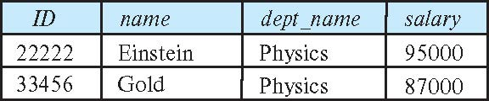
Select Operation
The select operation selects tuples that satisfy a given predicate.
Notation: σ _{p} (r)
p is called the selection predicate
Example: select those tuples of the instructor relation where the instructor is in the “Physics” department.
Query
σ _{dept_name=“Physics”} (instructor)
Result

Slide 38
Select Operation (Cont.)
We allow comparisons using
=, ≠, >, ≥. <. ≤
in the selection predicate.
We can combine several predicates into a larger predicate by using the connectives:
∧ (and), ∨ (or), ¬ (not)
Example: Find the instructors in Physics with a salary greater $90,000, we write:
σ _{dept_name=“Physics”} ∧ _{salary} > 90,000 (instructor)
Then select predicate may include comparisons between two attributes.
Example, find all departments whose name is the same as their building name:
σ _{dept_name=building} (department)

Slide 39
Project Operation
A unary operation that returns its argument relation, with certain attributes left out.
Notation:
∏ _{A1,A2,A3 ….Ak} (r)
where A₁, A₂ are attribute names and r is a relation name.
The result is defined as the relation of k columns obtained by erasing the columns that are not listed
Duplicate rows removed from result, since relations are sets

Slide 40
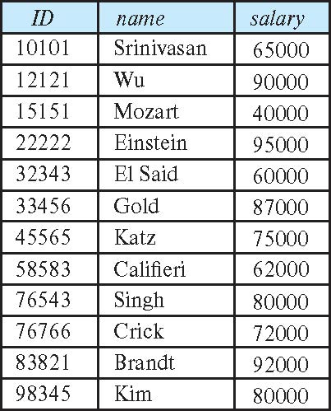
Project Operation (Cont.)
Example: eliminate the dept_name attribute of instructor
Query: ∏_{ID, name, salary} (instructor)
Result:

Slide 41
Composition of Relational Operations
The result of a relational-algebra operation is relation and therefore of relational-algebra operations can be composed together into a relational-algebra expression.
Consider the query -- Find the names of all instructors in the Physics department.
∏_{name}(σ _{dept_name} _{=“Physics”} (instructor))
Instead of giving the name of a relation as the argument of the projection operation, we give an expression that evaluates to a relation.

Slide 42
Cartesian-Product Operation
The Cartesian-product operation (denoted by X) allows us to combine information from any two relations.
Example: the Cartesian product of the relations instructor and teaches is written as:
instructor X teaches
We construct a tuple of the result out of each possible pair of tuples: one from the instructor relation and one from the teaches relation (see next slide)
Since the instructor ID appears in both relations we distinguish between these attribute by attaching to the attribute the name of the relation from which the attribute originally came.
instructor.ID
teaches.ID
R x R -> R f(x,y)->z

Slide 43
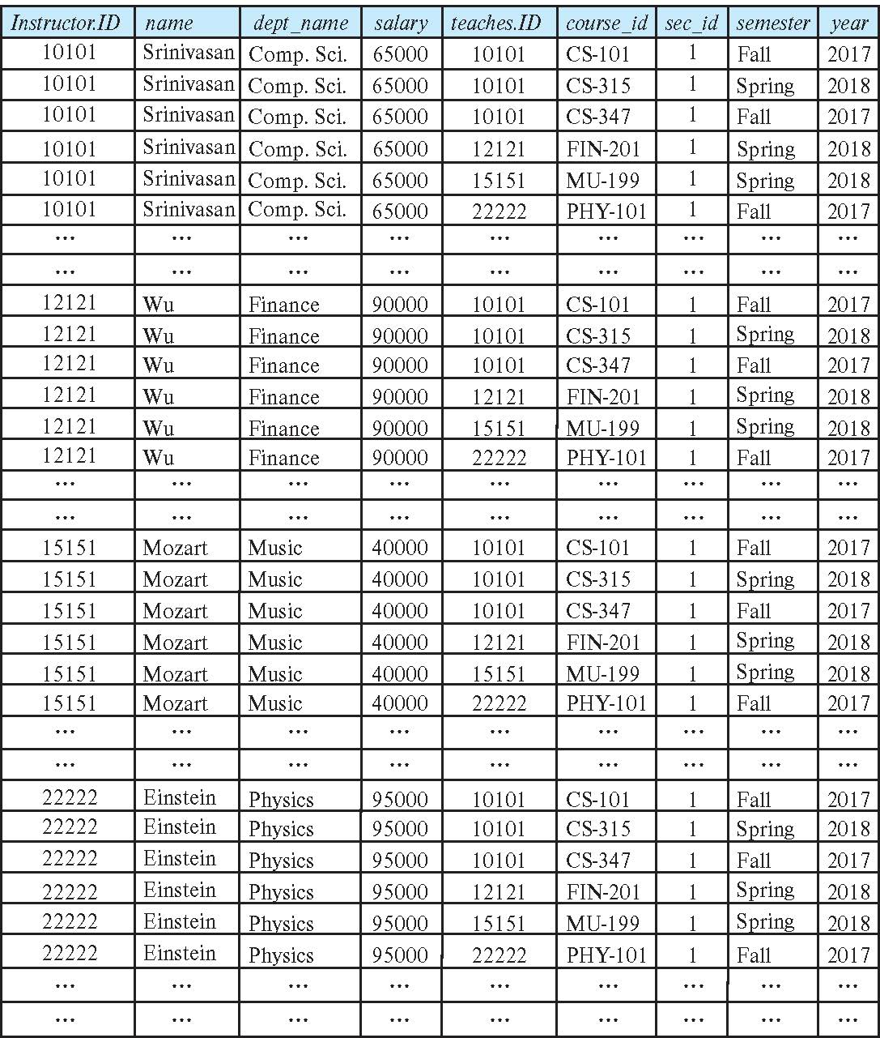
The instructor X teaches table
This only sort of makes sense. The result is:
Every possible combination of the form
(instructor, teaches)
Even if the instructor is NOT the instructor in the teaches row.
Examining in MySQL makes a little clearer.
Let’s look in the lecture examples notebook.
Confusingly, in SQL Cartesian Product is JOIN

Slide 44
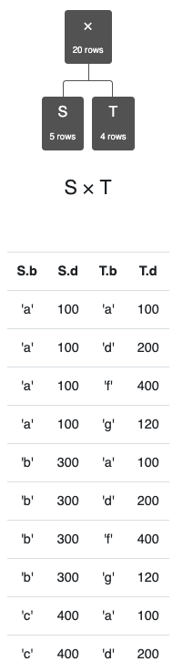
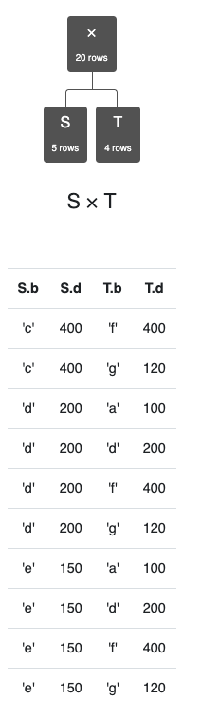
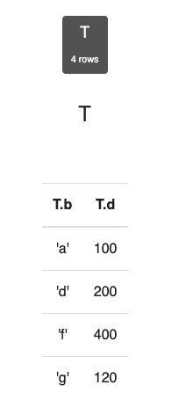
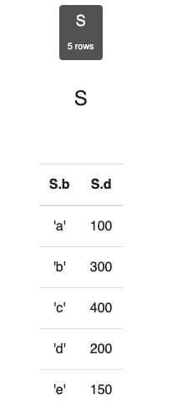
Simpler Example
Assume we have two tables
S has two columns, 5 rows.
T has two columns, 4 rows.
S x T has
4 columns.
20 rows.
Cartesian product does not come up a lot in applications.
There are cases in optimization in which:
You want to generate all possible combinations.
Score, rate, rank etc. to determine best choices.

Slide 45
Join Operation
The Cartesian-Product
instructor X teaches
associates every tuple of instructor with every tuple of teaches.
Most of the resulting rows have information about instructors who did NOT teach a particular course.
To get only those tuples of “instructor X teaches “ that pertain to instructors and the courses that they taught, we write:
σ _{instructor.id = teaches.id} (instructor x teaches ))
We get only those tuples of “instructor X teaches” that pertain to instructors and the courses that they taught.
The result of this expression, shown in the next slide
A fundamental definition:
σ _{instructor.ID=teaches.ID} (instructor ⨯ teaches) = instructor ⨝ teaches
⨝ is the JOIN operations.

Slide 46
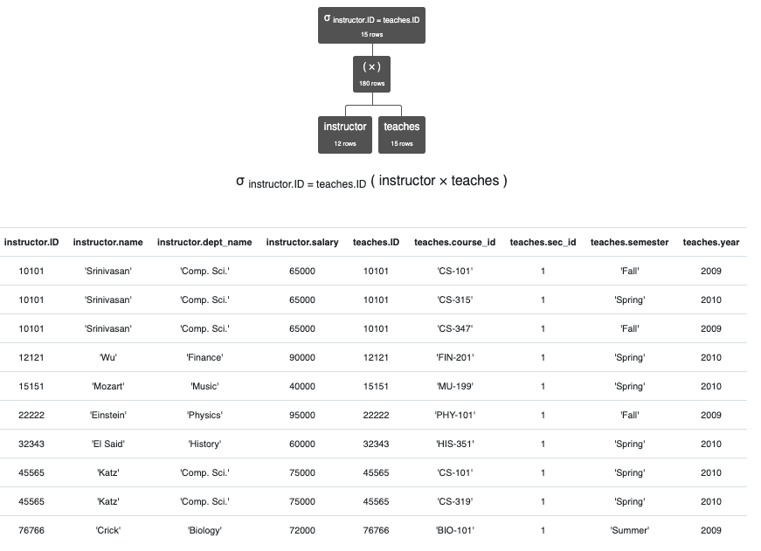
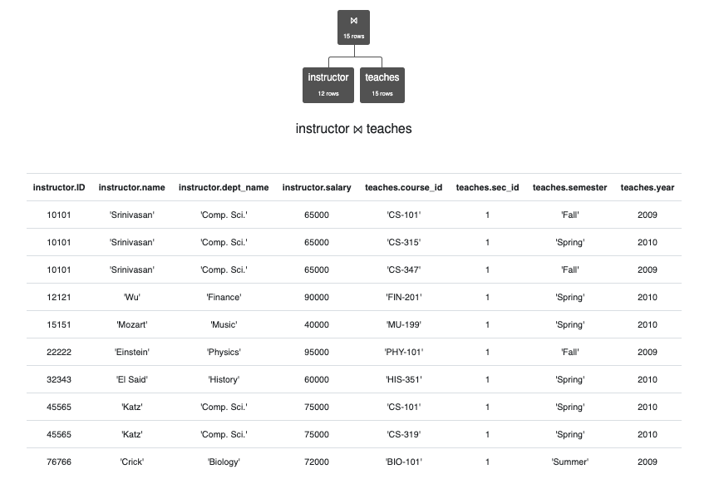
JOIN Definition
σ _{instructor.ID=teaches.ID} (instructor ⨯ teaches)
instructor ⨝ teaches
instructor ⨝ _{instructor.ID>teaches.ID} teaches

Slide 47
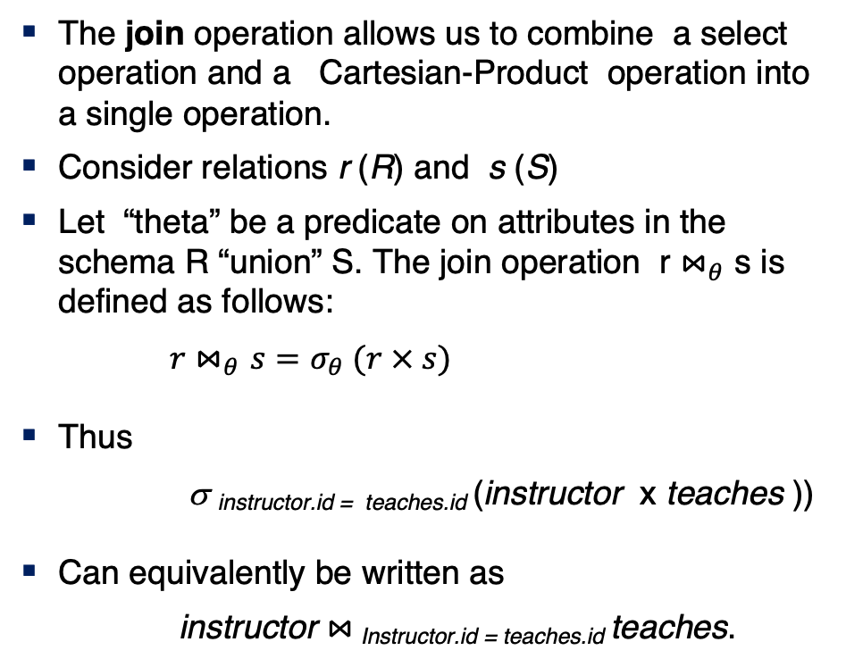
Join Operation (Cont.)
The join operation allows us to combine a select operation and a Cartesian-Product operation into a single operation.
Consider relations r (R) and s (S)
Let “theta” be a predicate on attributes in the schema R “union” S. The join operation r $⋈_{θ}$ s is defined as follows:
$r⋈_{θ}s=σ_{θ} (r × s)$
Thus
σ _{instructor.id = teaches.id} (instructor x teaches ))
Can equivalently be written as
instructor $⋈_{ }$_{Instructor.id = teaches.id} teaches.

Slide 48
The Dreaded Relax Calculator
Let’s look at an online tool that you will use.
RelaX (https://dbis-uibk.github.io/relax/calc/local/uibk/local/0)
The calculator:
Has an older version of the data from the recommended textbook. (https://dbis-uibk.github.io/relax/calc/gist/4f7866c17624ca9dfa85ed2482078be8/relax-silberschatz-english.txt/0)
You can also upload new data.
Some queries:
σ dept_name='Comp. Sci.' ∨ dept_name='History' (department)
π name, dept_name (instructor)
π ID, name ( σ dept_name='Comp. Sci.' (instructor) )

Slide 49
SQL
49 | COMS W4111_003_2024_3: Lecture 2: ER, Relational, SQL (I) © Donald F. Ferguson, 2024

Slide 50
History
IBM Sequel language developed as part of System R project at the IBM San Jose Research Laboratory
Renamed Structured Query Language (SQL)
ANSI and ISO standard SQL:
SQL-86
SQL-89
SQL-92
SQL:1999 (language name became Y2K compliant!)
SQL:2003
Commercial systems offer most, if not all, SQL-92 features, plus varying feature sets from later standards and special proprietary features.
Not all examples here may work on your particular system.

Slide 51
SQL Parts
DML -- provides the ability to query information from the database and to insert tuples into, delete tuples from, and modify tuples in the database.
integrity – the DDL includes commands for specifying integrity constraints.
View definition -- The DDL includes commands for defining views.
Transaction control –includes commands for specifying the beginning and ending of transactions.
Embedded SQL and dynamic SQL -- define how SQL statements can be embedded within general-purpose programming languages.
Authorization – includes commands for specifying access rights to relations and views.
DDL
DML

Slide 52
SQL Language Statements
The core SQL language statements are:
SELECT: Implements both σ, π
INSERT
UPDATE
DELETE
CREATE TABLE
ALTER TABLE
JOIN, which is an operator within SELECT.
Many, if not most, SQL statements:
Implement multiple relational algebra expressions.
Cannot easily (or at all) be represented in relational algebra.
π ID, name ( σ dept_name='Comp. Sci.' (instructor) )
=
SELECT ID, name FROM instructor WHERE
dept_name=‘Comp. Sci.’

Slide 53
Basic Query Structure
A typical SQL query has the form: select A₁, A₂, ..., A_{n} from r₁, r₂, ..., r_{m} where P
A_{i} represents an attribute
R_{i} represents a relation
P is a predicate.
The result of an SQL query is a relation.
Note:
The SELECT ... FROM ... WHERE ... Combines two relational operators, σ and ∏.
Actually, it also combines other operators, e.g. x
Notes:
2

Slide 54
The select Clause
The select clause lists the attributes desired in the result of a query
corresponds to the projection operation of the relational algebra
Example: find the names of all instructors: select name from instructor
NOTE: SQL names are case insensitive (i.e., you may use upper- or lower-case letters.)
E.g., Name ≡ NAME ≡ name
Some people use upper case wherever we use bold font.
Notes:
3

Slide 55
The select Clause (Cont.)
SQL allows duplicates in relations as well as in query results.
To force the elimination of duplicates, insert the keyword distinct after select.
Find the department names of all instructors, and remove duplicates
select distinct dept_name from instructor
The keyword all specifies that duplicates should not be removed.
select all dept_name from instructor
Notes:
4

Slide 56
The select Clause (Cont.)
An asterisk in the select clause denotes “all attributes”
select * from instructor
An attribute can be a literal with no from clause
select '437'
Results is a table with one column and a single row with value “437”
Can give the column a name using:
select '437' as FOO
An attribute can be a literal with from clause
select 'A' from instructor
Result is a table with one column and N rows (number of tuples in the instructors table), each row with value “A”
Notes:
5

Slide 57
The select Clause (Cont.)
The select clause can contain arithmetic expressions involving the operation, +, –, ∗, and /, and operating on constants or attributes of tuples.
The query:
select ID, name, salary/12 from instructor
would return a relation that is the same as the instructor relation, except that the value of the attribute salary is divided by 12.
Can rename “salary/12” using the as clause:
select ID, name, salary/12 as monthly_salary
Notes:
5

Slide 58
The where Clause
The where clause specifies conditions that the result must satisfy
Corresponds to the selection predicate of the relational algebra.
To find all instructors in Comp. Sci. dept
select name from instructor where dept_name = 'Comp. Sci.'
SQL allows the use of the logical connectives and, or, and not
The operands of the logical connectives can be expressions involving the comparison operators <, <=, >, >=, =, and <>.
Comparisons can be applied to results of arithmetic expressions
To find all instructors in Comp. Sci. dept with salary > 80000
select name from instructor where dept_name = 'Comp. Sci.' and salary > 80000
Notes:
6

Slide 59
The from Clause
The from clause lists the relations involved in the query
Corresponds to the Cartesian product operation of the relational algebra.
Find the Cartesian product instructor X teaches
select ∗ from instructor, teaches
generates every possible instructor – teaches pair, with all attributes from both relations.
For common attributes (e.g., ID), the attributes in the resulting table are renamed using the relation name (e.g., instructor.ID)
Cartesian product not very useful directly, but useful combined with where-clause condition (selection operation in relational algebra).
Notes:
8

Slide 60
Examples
Find the names of all instructors who have taught some course and the course_id
select name, course_id from instructor , teaches where instructor.ID = teaches.ID
Find the names of all instructors in the Art department who have taught some course and the course_id
select name, course_id from instructor , teaches where instructor.ID = teaches.ID and instructor. dept_name = 'Art'
Notes:
9

Slide 61
Data Definition Language
The SQL data-definition language (DDL) allows the specification of information about relations, including:
The schema for each relation.
The type of values associated with each attribute.
The Integrity constraints
The set of indices to be maintained for each relation.
Security and authorization information for each relation.
The physical storage structure of each relation on disk.

Slide 62
Create Table Construct
An SQL relation is defined using the create table command:
create table r
(A₁ D₁, A₂ D₂, ..., A_{n} D_{n}, (integrity-constraint₁), ..., (integrity-constraint_{k}))
r is the name of the relation
each A_{i} is an attribute name in the schema of relation r
D_{i} is the data type of values in the domain of attribute A_{i}
Example:
create table instructor ( ID char(5), name varchar(20), dept_name varchar(20), salary numeric(8,2))

Slide 63
The Rename Operation
The SQL allows renaming relations and attributes using the as clause:
old-name as new-name
Find the names of all instructors who have a higher salary than some instructor in 'Comp. Sci'.
select distinct T.name from instructor as T, instructor as S where T.salary > S.salary and S.dept_name = 'Comp. Sci.’
Keyword as is optional and may be omitted instructor as T ≡ instructor T
Notes:
9

Slide 64
Null Values
It is possible for tuples to have a null value, denoted by null, for some of their attributes
null signifies an unknown value or that a value does not exist.
The result of any arithmetic expression involving null is null
Example: 5 + null returns null
The predicate is null can be used to check for null values.
Example: Find all instructors whose salary is null.
select name from instructor where salary is null
The predicate is not null succeeds if the value on which it is applied is not null.
Note:
NULL is an extremely important concept.
You will find it hard to understand for a while.

Slide 65
Null Values (Cont.)
SQL treats as unknown the result of any comparison involving a null value (other than predicates is null and is not null).
Example: 5 < null or null <> null or null = null
The predicate in a where clause can involve Boolean operations (and, or, not); thus the definitions of the Boolean operations need to be extended to deal with the value unknown.
and : (true and unknown) = unknown, (false and unknown) = false, (unknown and unknown) = unknown
or: (unknown or true) = true, (unknown or false) = unknown (unknown or unknown) = unknown
Result of where clause predicate is treated as false if it evaluates to unknown

Slide 66
Modification of the Database
Deletion of tuples from a given relation.
Insertion of new tuples into a given relation
Updating of values in some tuples in a given relation

Slide 67
Deletion
Delete all instructors
delete from instructor
Delete all instructors from the Finance department delete from instructor where dept_name= 'Finance’;
Delete all tuples in the instructor relation for those instructors associated with a department located in the Watson building.
delete from instructor where dept name in (select dept name from department where building = 'Watson');

Slide 68
Deletion (Cont.)
Delete all instructors whose salary is less than the average salary of instructors
Problem: as we delete tuples from instructor, the average salary changes
Solution used in SQL:
First, compute avg (salary) and find all tuples to delete
Next, delete all tuples found above (without recomputing avg or retesting the tuples)
delete from instructor
where salary < (select avg (salary)
from instructor);

Slide 69
Insertion
Add a new tuple to course
insert into course values ('CS-437', 'Database Systems', 'Comp. Sci.', 4);
or equivalently
insert into course (course_id, title, dept_name, credits) values ('CS-437', 'Database Systems', 'Comp. Sci.', 4);
Add a new tuple to student with tot_creds set to null
insert into student values ('3003', 'Green', 'Finance', null);

Slide 70
Insertion (Cont.)
Make each student in the Music department who has earned more than 144 credit hours an instructor in the Music department with a salary of $18,000.
insert into instructor select ID, name, dept_name, 18000 from student where dept_name = 'Music' and total_cred > 144;
The select from where statement is evaluated fully before any of its results are inserted into the relation.
Otherwise queries like
insert into table1 select * from table1
would cause problem

Slide 71
Updates
Give a 5% salary raise to all instructors
update instructor set salary = salary * 1.05
Give a 5% salary raise to those instructors who earn less than 70000 update instructor set salary = salary * 1.05 where salary < 70000;
Give a 5% salary raise to instructors whose salary is less than average
update instructor set salary = salary * 1.05 where salary < (select avg (salary) from instructor);

Slide 72
Updates (Cont.)
Increase salaries of instructors whose salary is over $100,000 by 3%, and all others by a 5%
Write two update statements:
update instructor set salary = salary * 1.03 where salary > 100000; update instructor set salary = salary * 1.05 where salary <= 100000;
The order is important
Can be done better using the case statement (next slide)

Slide 73
Time for Some Hands On?
73 | COMS W4111_003_2024_3: Lecture 2: ER, Relational, SQL (I) © Donald F. Ferguson, 2024

Slide 74
Homework → Incremental Project
74 | COMS W4111_003_2024_3: Lecture 2: ER, Relational, SQL (I) © Donald F. Ferguson, 2024

Slide 75
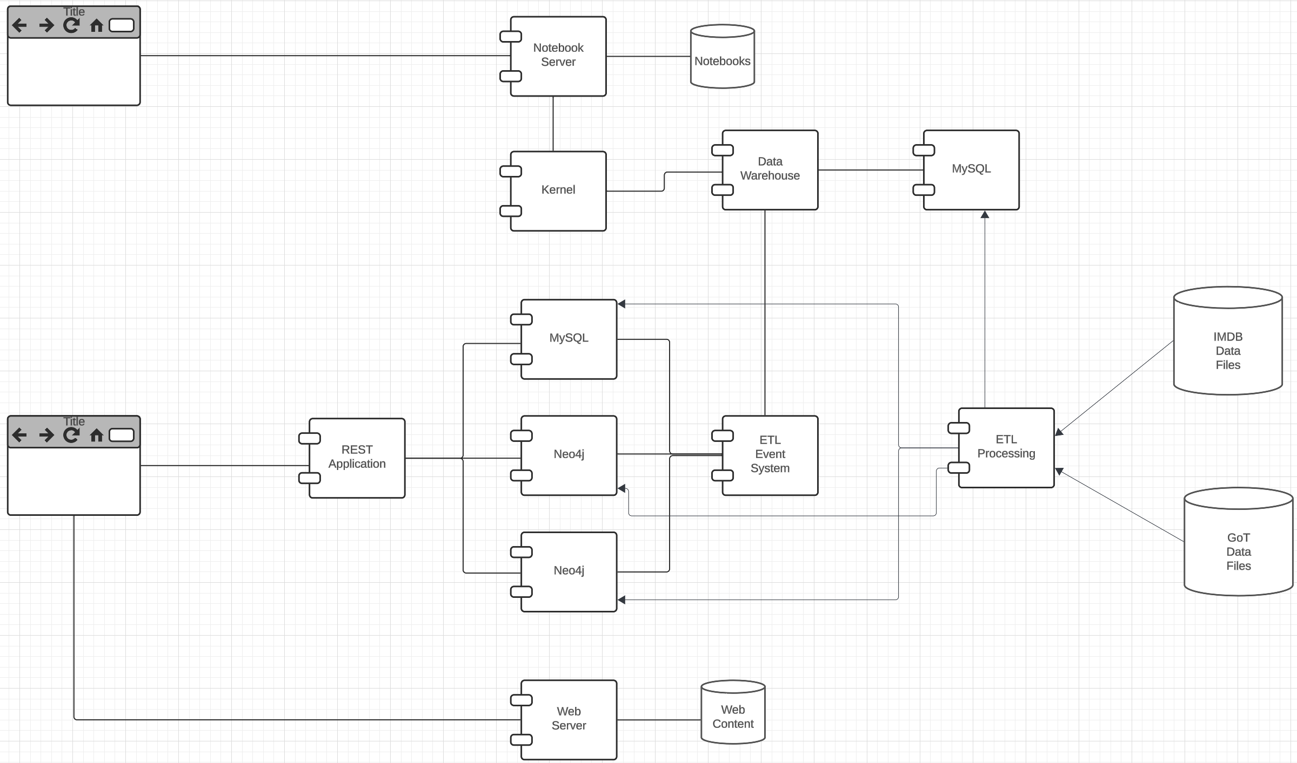
HWs → Incremental Project
Programming track will build a simple, interactive web application.
Non-programming track will build a simple data engineering and insight system.
The TAs and I will provide much of the infrastructure and environment starter/templates.
You will define small individual projects/scenarios and pick the data sets.
We will do worked examples.

Slide 76
Wrap Up
76 | COMS W4111_003_2024_3: Lecture 2: ER, Relational, SQL (I) © Donald F. Ferguson, 2024

